Slide 1


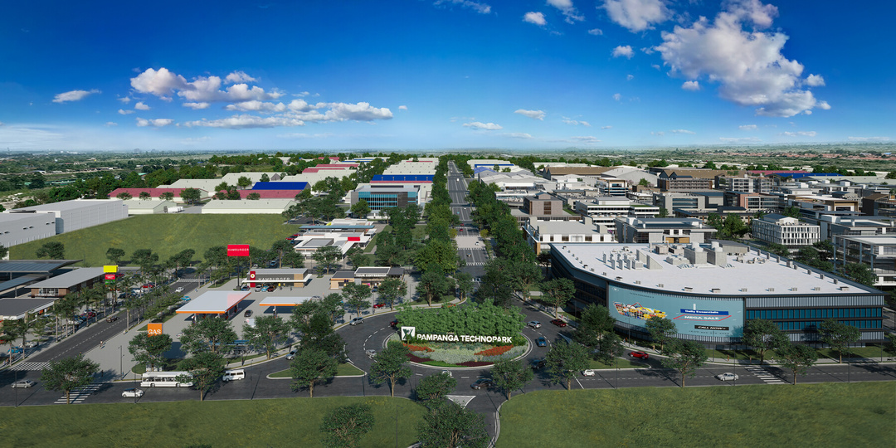


DECEMBER 2023
Artist's perspective
PAMPANGA TECHNOPARK COMMERCIAL
Mabalacat City, Pampanga
A 192-hectare masterplanned industrial park township set to rise in Northern Luzon, Pampanga Technopark is the country’s first agro- industrial and commercial hub where trade, commerce and communities come together in one dynamic business environment.
SCAN TO TAKE A VIRTUAL TOUR
For inquiries, kindly email:
peregrino.mae@ayalalandpremier.com mae.ayalalandpremier@gmail.com
Whatsapp

Slide 2

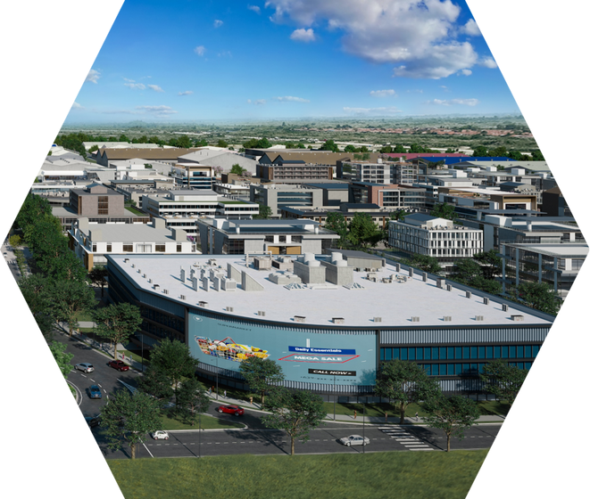
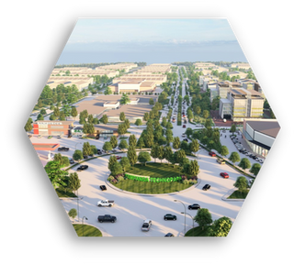
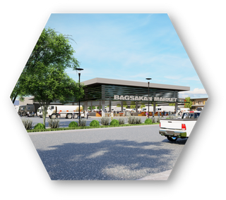
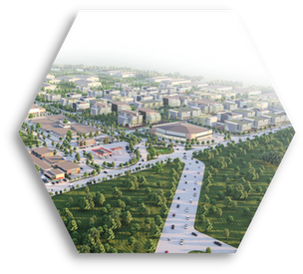
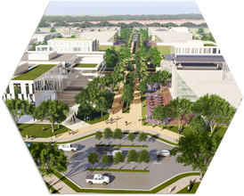
COMMERCIAL
SELLING PRICE
Php 40,000.00/sqm (VAT ex)
Ratesandavailability aresubjectto
change without prior notice
AVAILABLE LOTS
Lot 3: 2,971 sqm Lot 4: 1,873 sqm Lot 5: 1,752 sqm Lot 7: 1,170 sqm Lot 8: 1,166 sqm Lot 11: 1,348 sqm
Block 2
Block 3
Lot 12: 1,415 sqm Lot 14: 1,593 sqm Lot 15: 1,614 sqm Lot 17: 1,582 sqm Lot 18: 1,582 sqm
Lot 2: 3,259 sqm Lot 4: 1,680 sqm Lot 7: 2,961 sqm Lot 8: 2,961 sqm Lot 14: 3,259 sqm
Block 12
Lot 1: 4,606 sqm Lot 2: 4,331 sqm Lot 4: 4,331 sqm Lot 6: 4,331 sqm Lot 7: 4,175 sqm
GATHERING PLACE
Artist's perspective
BASIC COMMUNITY RETAIL
CENTRO
Centro is the heart of Pampanga Technopark, throbbing with retail stores, co-working
offices,
business
hotels,
LOCAL PRIDE RETAIL
spaces, and dormitories.
Anchoring the Centro is the Plaza, the activities
township’s
hub
for
social
characterized by four exciting concepts
STREET PLAZA

Slide 3

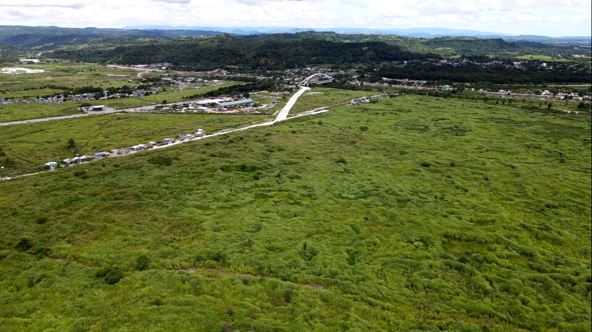
DECEMBER 2023
PAMPANGA TECHNOPARK
Mabalacat City, Pampanga
An Industrial Zone registered with the Board of Investments that offers industrial lots intended for light and medium, non-polluting industries such as electronics, automotive, consumer products, pharmaceuticals, logistics and warehousing, among others.
SCAN TO TAKE A VIRTUAL TOUR

Slide 4
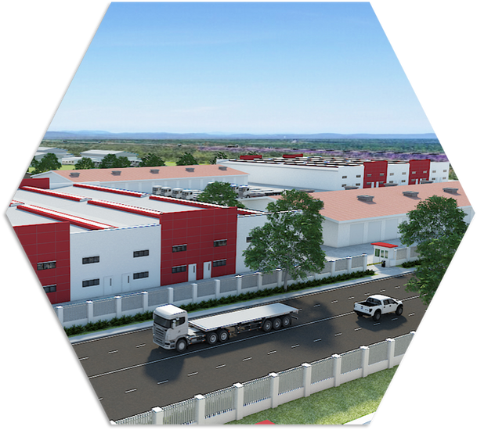
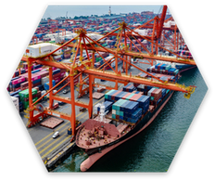

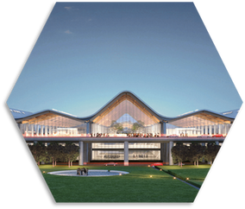
For inquiries, kindly email:
peregrino.mae@ayalalandpremier.com
mae.ayalalandpremier@gmail.com
Whatsapp
INDUSTRIAL
SELLING PRICE
PHASE 2
Php 9,000.00/sqm (VAT ex)
PHASE 3
Php 10,000.00/sqm (VAT ex)
Ratesandavailability aresubjectto
change without prior notice
AVAILABLE LOTS
Phase 2
Phase 3
Block 16
Block 6
Block 8
Lot 8: 9,716 sqm Lot 9: 10,180 sqm Lot 10: 10,185 sqm Lot 11: 11,295 sqm Lot 12: 9,404 sqm
Lot10:10,228 sqm
Lot7:10,189 sqm
Block 7
Lot6:10,550 sqm
Artist's perspective
Accessible via Major Thoroughfares
Mabalacat City is one of the biggest transportation hubs in Luzon with major road networks, like NLEX and SCTEX, cutting across the region. The North-South Commuter Railway project by the DPWH that will soon connect the existing Tutuban station to Clark, will contribute to the city's economic progress.
Gateway to International Market
Pampanga Technopark is strategically located near major facilities such as Clark International Airport and Subic Bay International Terminal.

Slide 5
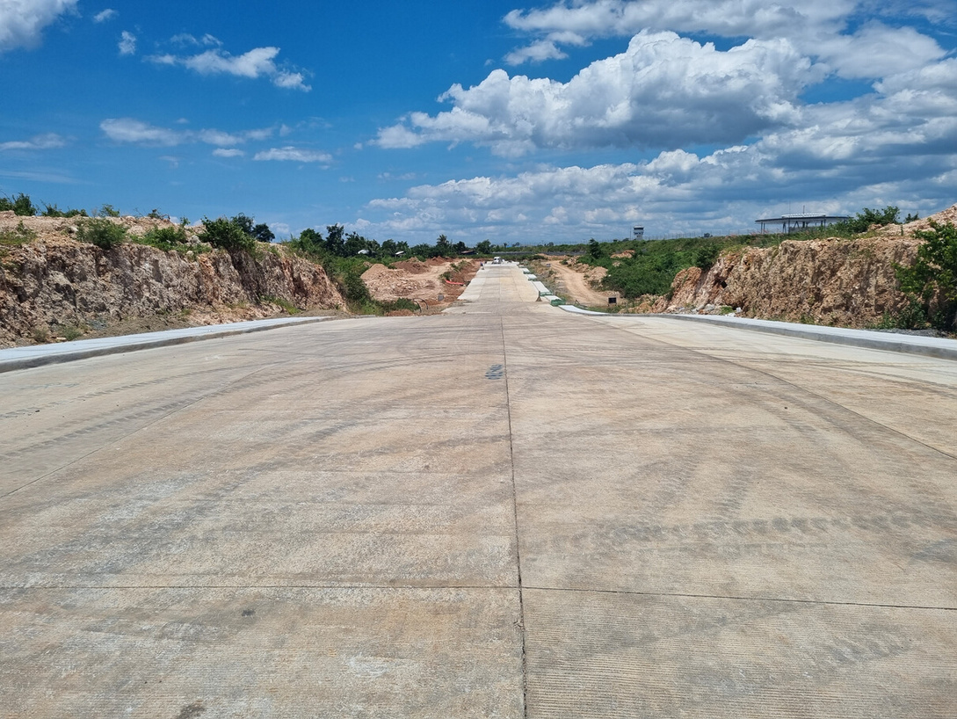

DECEMBER 2023
LAGUINDINGAN TECHNOPARK
Habini Bay, Laguindingan, Misamis Oriental
An Industrial Zone registered with the Board of Investments that offers industrial lots intended for light and medium, non-polluting industries. Laguindingan Technopark is part of Habini Bay- a 526-hectare master- planned estate of Ayala Land.
SCAN TO TAKE A VIRTUAL TOUR

Slide 6
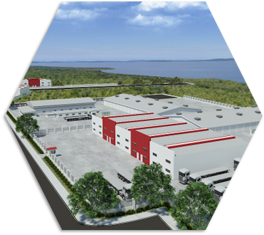

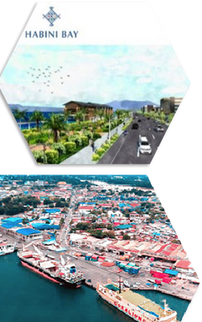
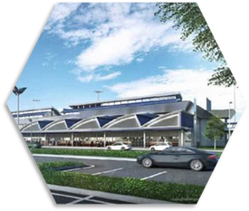
For inquiries, kindly email:
peregrino.mae@ayalalandpremier.com
mae.ayalalandpremier@gmail.com
SELLING PRICE
Php 6,000.00/sqm (VAT ex)
Ratesandavailability aresubjectto
change without prior notice
AVAILABLE LOTS
Block 1
Lot 1: 5,169 sqm Lot 2: 6,970 sqm Lot 3: 6,136 sqm Lot 4: 7,829 sqm Lot 5: 7,829 sqm Lot 6: 5,213 sqm Lot 7: 6,130 sqm Lot 8: 6,694 sqm Lot 9: 7,177 sqm Lot 10: 7,046 sqm Lot 11: 7,909 sqm Lot 12: 6,065 sqm Lot 14: 10,078 sqm Lot 15: 10,489 sqm Lot 16: 7,203 sqm
Block 2
Lot 1: 5,635 sqm Lot 2: 5,345 sqm
Lot 4: 4,283 sqm Lot 5: 4,916 sqm Lot 6: 4,955 sqm
Block 3
Lot 1: 5,417 sqm Lot 2: 5,449 sqm Lot 3: 7,101 sqm Lot 4: 9,567 sqm Lot 5: 6,558 sqm Lot 10: 7,178 sqm Lot 12: 6,890 sqm Lot 14: 8,200 sqm Lot 15: 8,820 sqm Lot 16: 8,801 sqm
Lot 3: 5,357 sqm
Artist's perspective
Block 4
Lot 1: 7,715 sqm Lot 2: 8,721 sqm Lot 3: 7,614 sqm Lot 4: 6,401 sqm
Block 5
Lot1:12,922 sqm
Block 6
Lot3:6,867 sqm
Gateway to International Market
Laguindingan Technopark is strategically located beside the Laguindingan International Airport (LIA) and in close proximity to Cagayan de Oro Port. The 240-km Trans-Mindanao Superhighway project of DPWH will soon link Tandag, Surigao del Sur to LIA. These infrastructures and developments make Laguindingan Technopark highly accessible and favorable to both foreign and domestic investors.

Slide 7
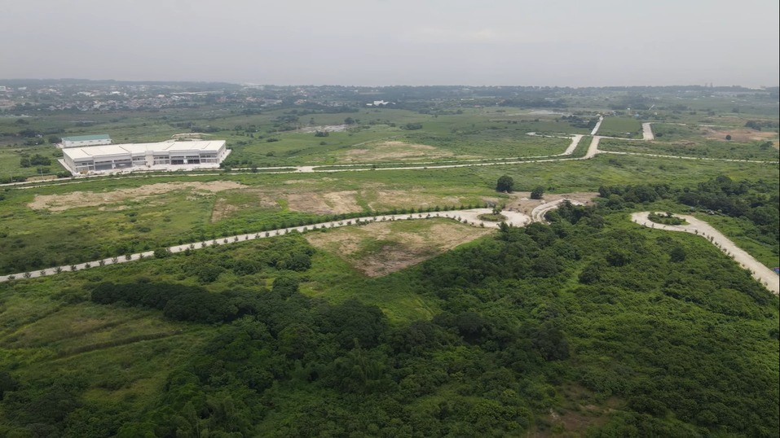

DECEMBER 2023
CAVITE TECHNOPARK
Governor's Drive, Naic, Cavite
Cavite Technopark caters to both PEZA and non-PEZA locator- companies engaged in electronics, automotive, consumer products, pharmaceuticals, warehousing and logistics, among others.
SCAN TO TAKE A VIRTUAL TOUR

Slide 8

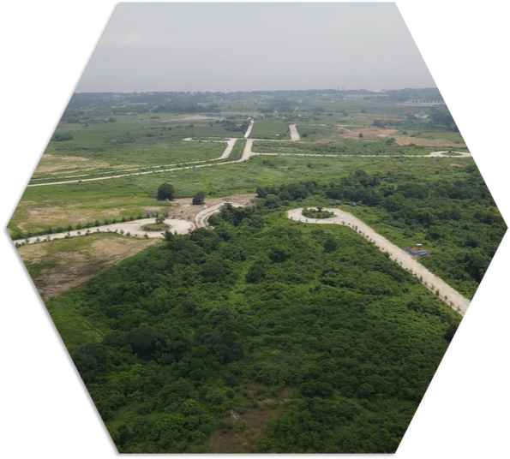
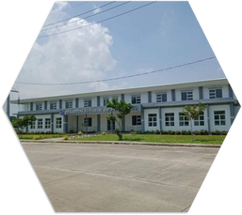
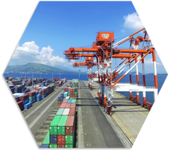
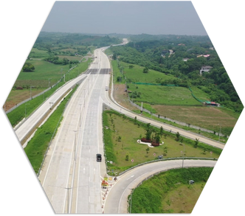
For inquiries, kindly email:
peregrino.mae@ayalalandpremier.com
mae.ayalalandpremier@gmail.com
SELLING PRICE
Php 9,000.00/sqm (VAT ex)
Phase 1 (PEZA) Phase 3 (Non-PEZA)
Rates and availability are subject to change without prior notice
AVAILABLE LOTS
Phase 1 - PEZA
Phase 3 - Non-PEZA
Lot 40:10,070 sqm
Block 3
Block 4
Lot 49-F-6-A: 9,577 sqm Lot 48-A: 2,568 sqm
Lot 2: 8,348 sqm
Lot 1: 8,979 sqm Lot 2: 6,877 sqm Lot 3: 9,030 sqm
Ease of Doing Business
Cavite Technopark is equipped with satellite government offices such as Bureau of Customs and PEZA. It is also located approximately 8km away from Cavite Gateway Terminal, a barge terminal operated by ICTSI. The presence of these infrastructures makes Cavite an ideal launch pad for businesses across the globe.
Accessible via Major Thoroughfares
The development is highly accessible through highways and expressways such as South-Luzon Expressway, Manila-Cavite Expressway, Governor's Drive, and the ongoing Cavite-Laguna Expressway.

